Slide 1

Comparative analysis of RC and MTGNN models on Multidimensional time-series prediction
Group 6

Slide 2

Reservoir Computing
Although the time-series problem can be solved by traditional models, there are problems such as complex algorithms, large computational effort, slow convergence, difficulty in determining the network structure, and memory fading, etc. RC is a good solution to these problems.

Slide 3
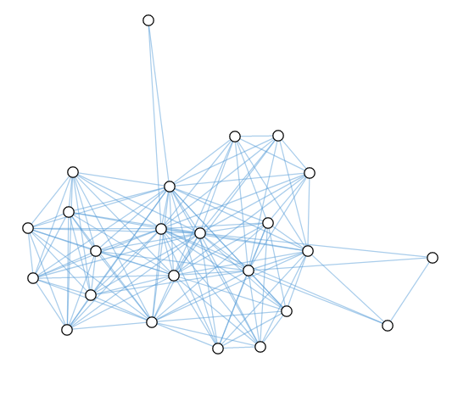
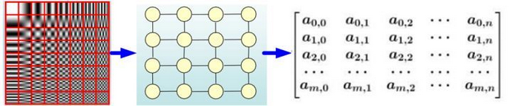
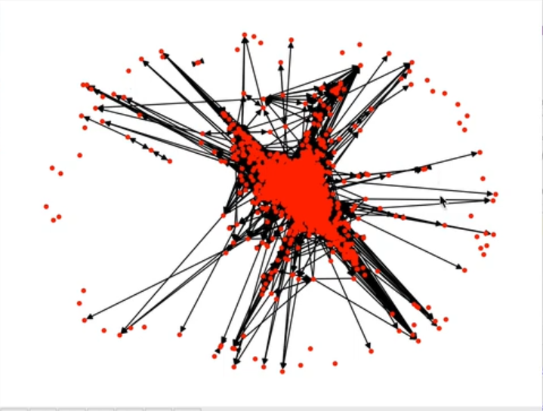
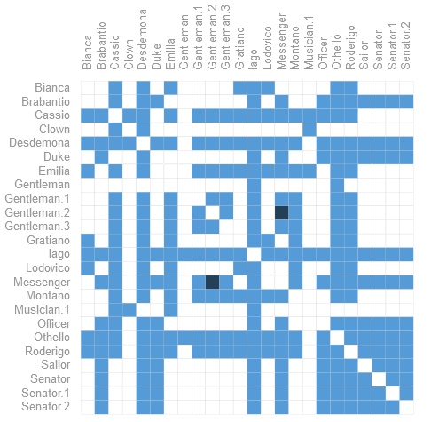
Graph data
Euclidean Structure Data
Data like image or video where each node are tightly connected to their neighbor.
Non-Euclidean Structure Data
Data connected by edge with weight.
Often represent with sparse matrix.
Some point are close to each other but not connected.

Slide 4
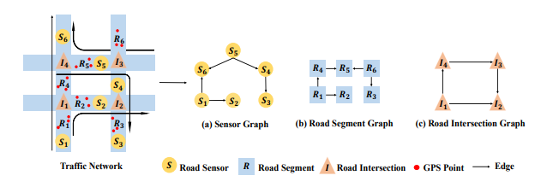
Graph data
Commonly used in traffic, geographic and weather domain
Complex relationship between nodes.
There are place that was blocked and direction edge.

Slide 5
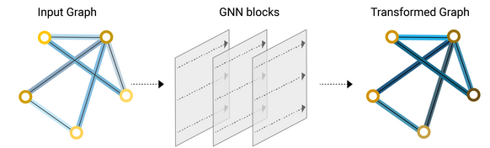
Graph Conv Network
Basically a CNN using Graph data
Graph input and same graph structure output.
.

Slide 6
Graph-Based Network
Spatial connection
Temporal connection
Graph convolution layer to extract relation between nodes.
TCN to simulate LSTM for time series prediction.
Residual connection
To make the network trainable.
Data preprocessing
Skip connection
To convert time series to graph
Using neural network for embedding
To concatenate information from different level.

Slide 7
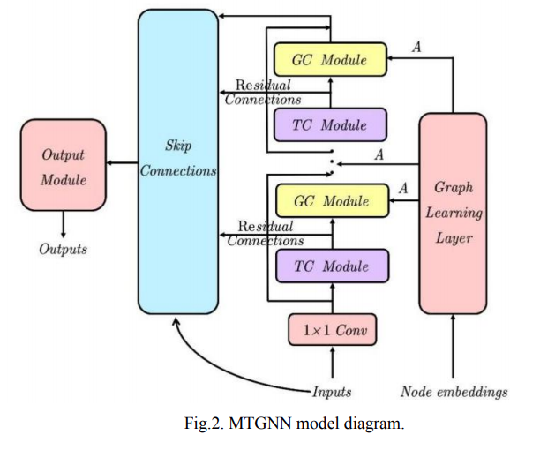
MT-GNN
GC module
Graph Convolution.
TC module
Temporal convolution

Slide 8
步骤 Steps
subject
data cleanning
time-series model
kaggle
model training
evaluation
RMSE

Slide 9

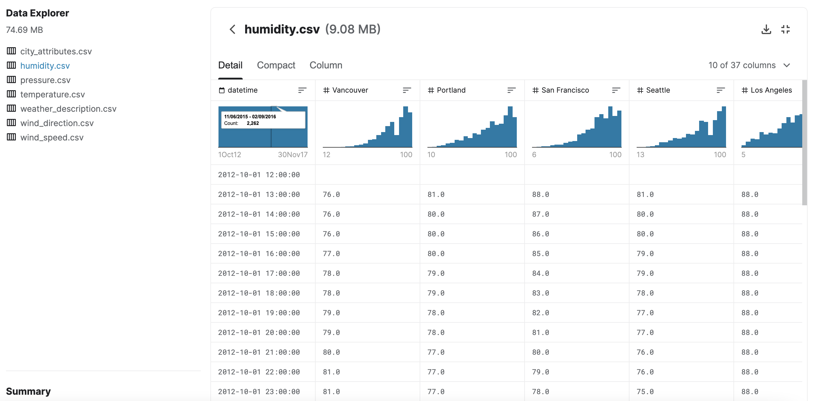

Slide 10
model training
reservoir
it must be made up of individual, non-linear units, and it must be capable of storing information.
Reservoirs are able to store information by connecting the units in recurrent loops, where the previous input affects the next response. The change in reaction due to the past allows the computers to be trained to complete specific tasks.
unlike neural networks, the connections between units are randomized and remain unchanged throughout computation

Slide 11
model training
readout layer
a neural network layer that performs a linear transformation on the output of the reservoir.
The weights of the readout layer are trained by analyzing the spatiotemporal patterns of the reservoir after excitation by known inputs, and by utilizing a training method such as a linear regression or a Ridge regression

Slide 12
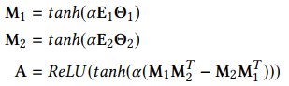
Graph learning module
The module learns structure and data parameters at the same time
E represents randomly initialized node embeddings
M represents graph learned by linear layer
A represents the adjacency matrix

Slide 13
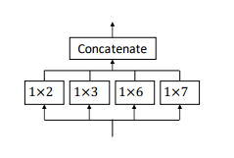
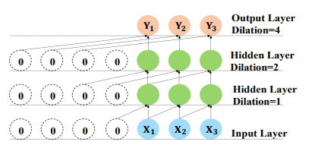
TC module
TCN with inception structure
Can provide Richer spatial features

Slide 14
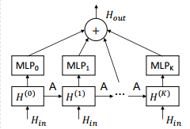

GC module
A CNN like module
$H_{in}$ represent the input data in time
A is the adjacency matrix
Graph conv layer using data in time series and graph structure data to merge information.
Finally using MLP to select information.

Slide 15
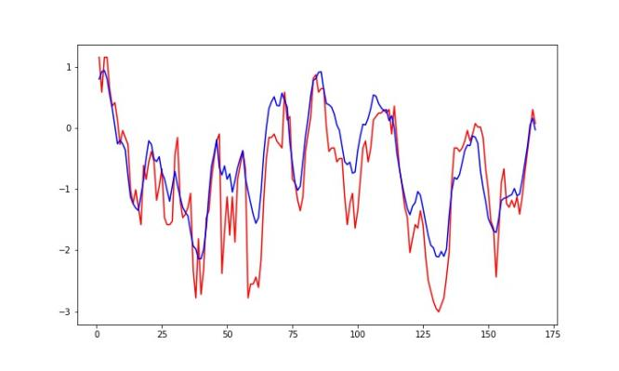
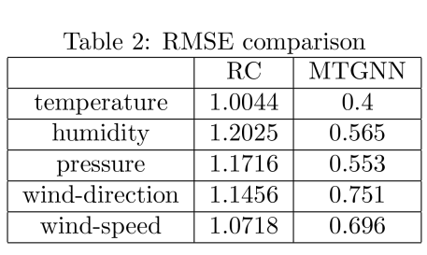
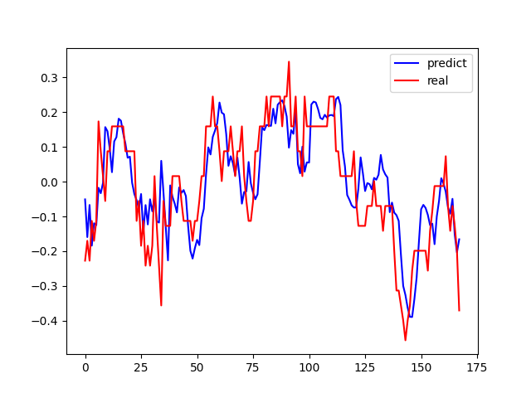
evaluation

Slide 16
conclusion
what we expect
What we speculated
urban traffic, air quality monitoring,etc
MTGNN uses multiple indicators as nodes of the graph for prediction,
RC can only transform multidimensional time series into matrices, ignoring the correlation between nodes.
What we found
What we did
MTGNN is significantly better than RC in time series prediction.
compares RC and MTGNN in time series prediction.
On the public dataset of kaggle,
trained the model
calculated the error value

Slide 17


Slide 18
thanks
Group 6

